Slide 1
Mimic Visualization Factors affecting mortality
Qasim Khan

Slide 2
Loading Datasets
First, we need to load the data we are going to use in pandas data frames.
PATIENTS.csv
ADMISSIONS.csv
DIAGNOSES_ICD.csv
D_ICD_DIAGNOSES.csv
ICUSTAYS.csv
PROCEDURES_ICD.csv
PRESCRITPTIONS.csv

Slide 3
Merging Datasets
We want to see what factors impact the mortality of patients during their stays in the ICU.
In order to do this, we will need to merge our ICU stays data with our admissions data.
This will let us know the mortality of each entry in our ICU stays data frame.
We will also merge the prescriptions dataset with the newly created data frame to get their medication information too
icu_admissions = icustays.merge(admissions[['hadm_id', 'hospital_expire_flag']], on='hadm_id', how='left’)
prescriptions_count = prescriptions.groupby('hadm_id').size().reset_index(name='medication_count')
icu_admissions = icu_admissions.merge(prescriptions_count, on='hadm_id', how='left')

Slide 4
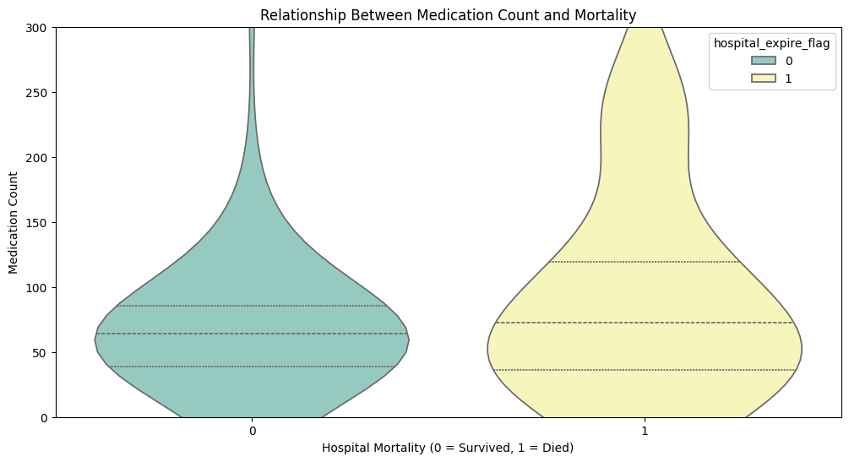
Relationship between medication and mortality
From this data we can see that more people passed away who take higher amounts of medication as compared to people who survived
We created a Violin Plot and set the y limit to 300 to ignore outliers

Slide 5
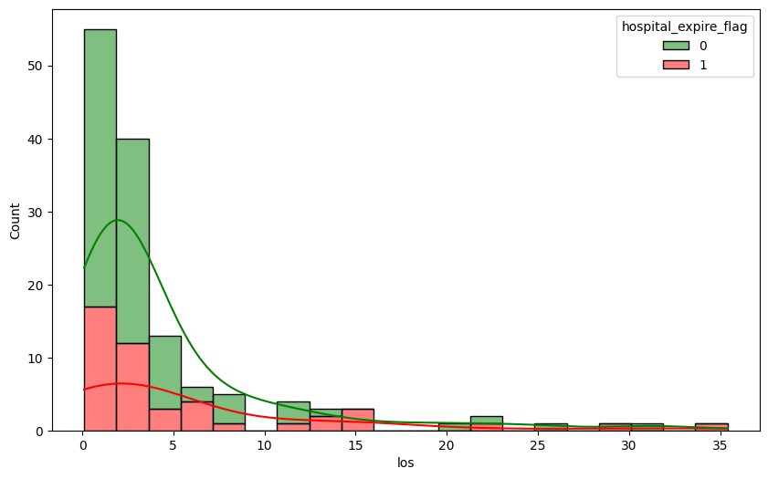
Relationship between length of stay and mortality

Slide 6
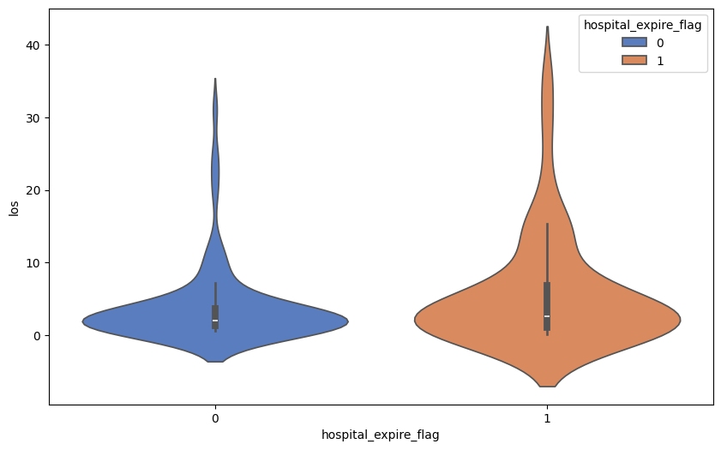
Relationship between length of stay and mortality

Slide 7
Relationship between length of stay and mortality
From the violin plot and histogram, we can see that majority of the patients stay in the ICU for less than 10 days.
We can also see that how long someone stays in the ICU probably does not influence if they die or not. Day 15 has no survivors but day 20 has no deaths. then after that we can see a mix of the two. This means that ICU stay duration does not influence the survival of the patients
The violin plot shows the spread and density of stay lengths for each group, while the histogram stacks their distributions with green for survivors and red for deceased, making it easy to spot differences.

Slide 8
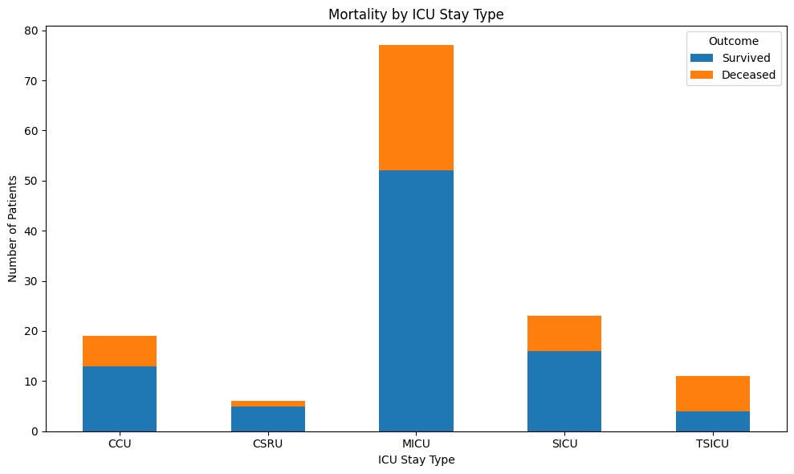
Which ICU stay type has the highest mortality
The code creates a stacked bar chart using the ICU stay and admissions datasets to show the relationship between ICU Stay type and patient mortality.
We group data by stay type and mortality status, count how many patients are In each group and display them by their mortality status for each stay type.
From the above chart we can see that TSICU has the highest mortality rate

Slide 9
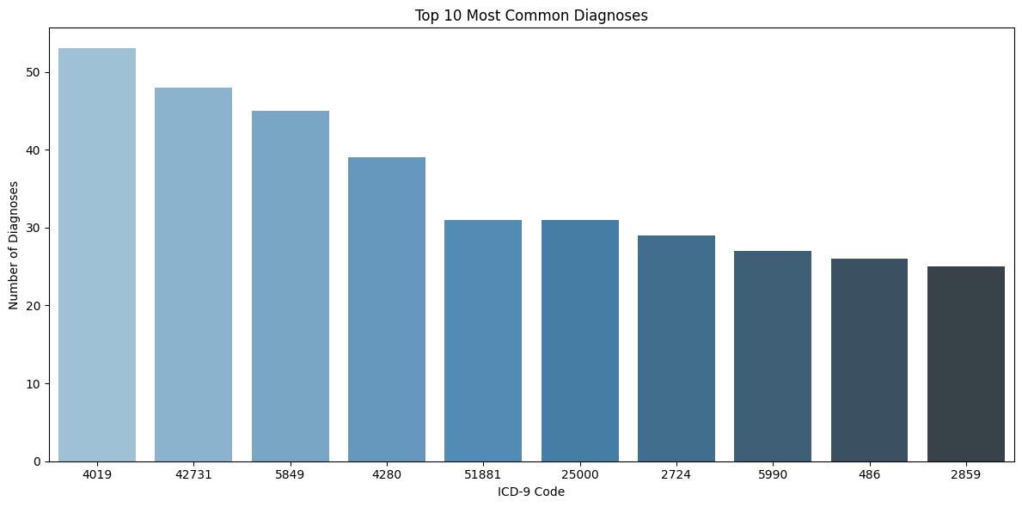
What are the most common diagnoses
First, we get the most common diagnoses by their ICD-9 codes using the diagnoses dataset and then display the top 10 most common ones.

Slide 10
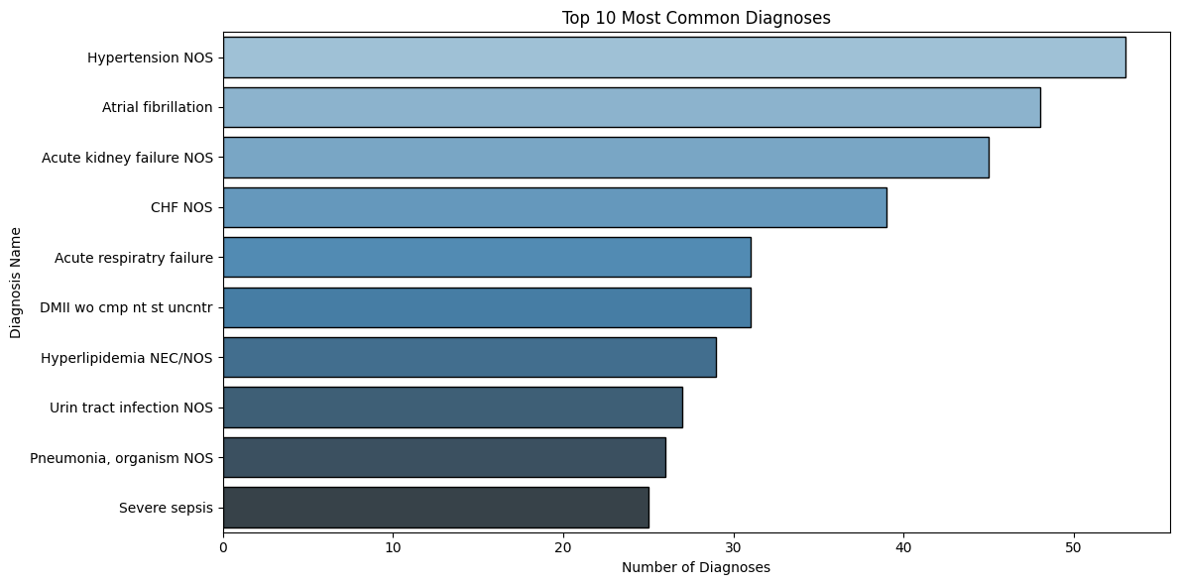
Most common diagnoses in human readable format
This code combines diagnosis data with labels and admissions information to include diagnosis names and patient outcomes.
It identifies the 10 most common diagnoses by name and visualizes them in a horizontal bar chart.
The chart shows the same data as the previous chart in a human readable format

Slide 11
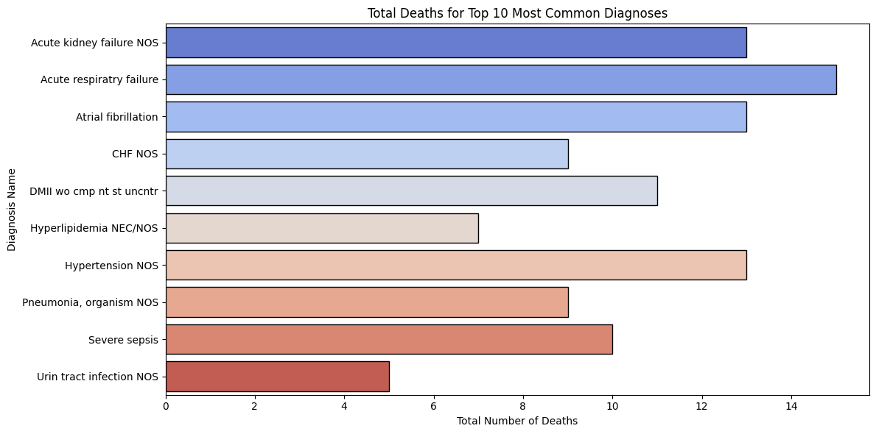
Mortality of most common diagnoses
This code calculates the total number of deaths associated with the top 10 most common diagnoses. It filters the dataset to include only records with diagnoses in the top 10, then groups the data by diagnosis name and sums the hospital_expire_flag, which indicates mortality. The result is a breakdown of deaths for each of the most frequent diagnoses.
Here we can see that Acute respiratory failure, Atrial fibrillation, and Acute kidney failure have the highest mortality

Slide 12
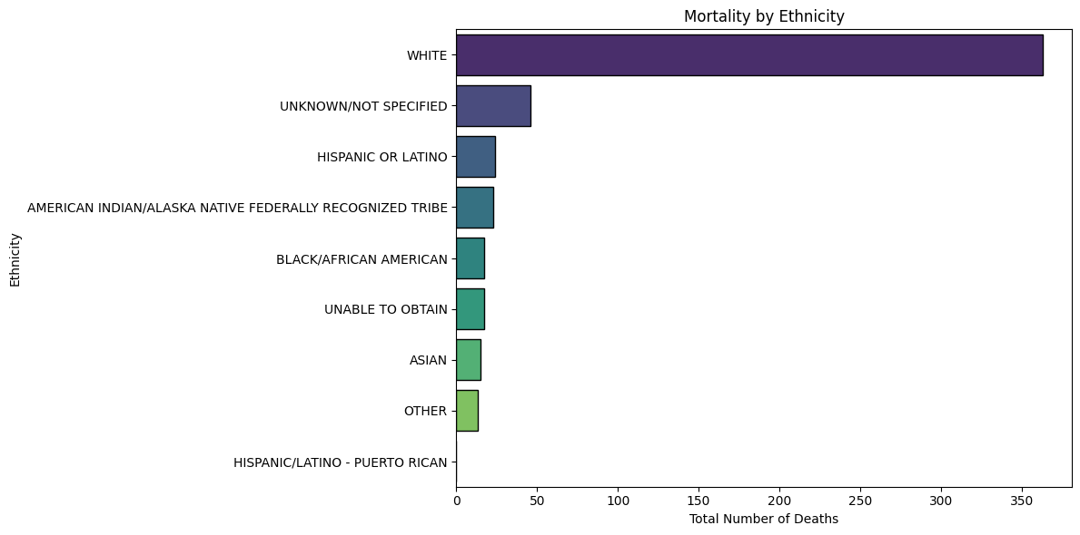
Which ethnicity has the highest mortality
The code groups the merged diagnoses and admissions dataset by ethnicity and mortality and calculate the total deaths for each ethnicity.
Here we can see that White people have the highest mortality. Could this be due to inconsistencies in our data?

Slide 13
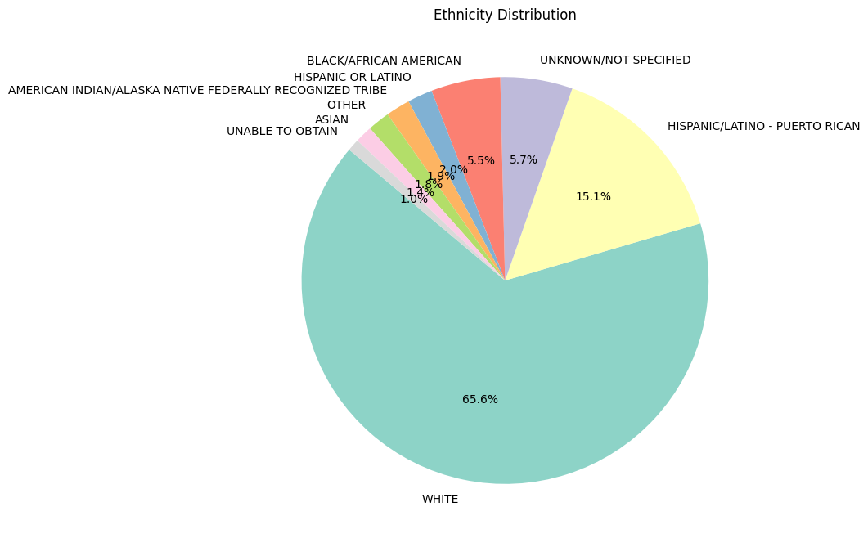
Deep dive on ethnicities effect on mortality
The code counts how many times each ethnicity appears in the diagnoses admissions dataset to show a breakdown of the distribution
Since White accounts for 66% of our data, this is why they have the highest mortality. They are overrepresented.

Slide 14
Link to notebook for details on implementation
https://github.com/QasimKhan30/Mimic-Visualization

